Slide 1
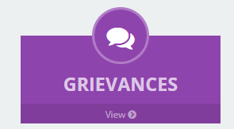
RAGHU ERP solution

Slide 2
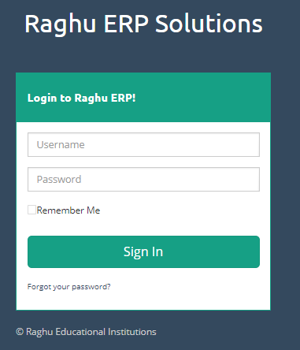
ERP Login Page
Step 1:
URL to login to ERP
http://210.16.79.137/raghuerp/login
Step 2:
Enter user name And password
Step 3:
Click on Sign In button

Slide 3
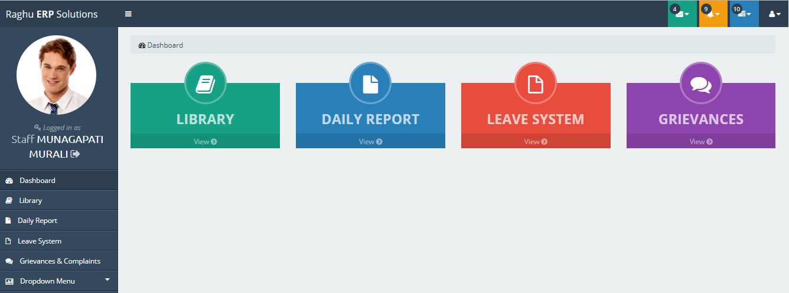
Home page Menu list
Click on Leave System

Slide 4
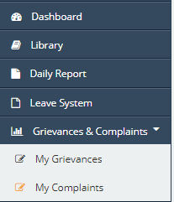
Grievances & Complaints Menu
Step 1:
Click on Grievances & Complaints
Step 2:
Click on My Grievances

Slide 5
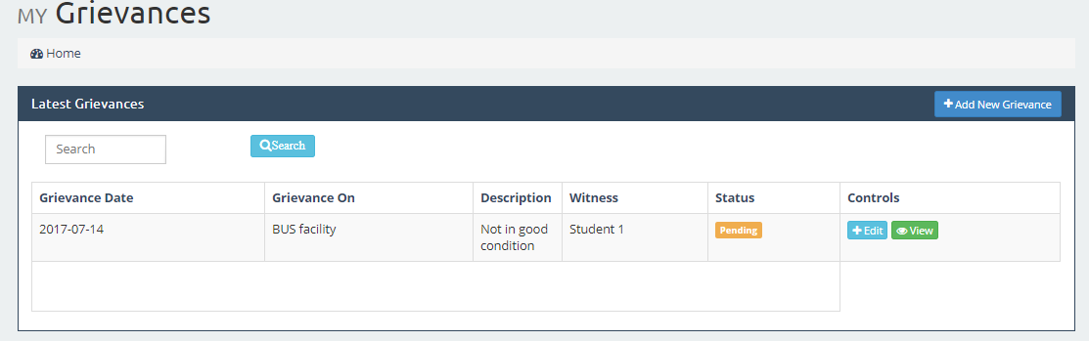
To Add New Grievance
Click on Add New Grievance button

Slide 6
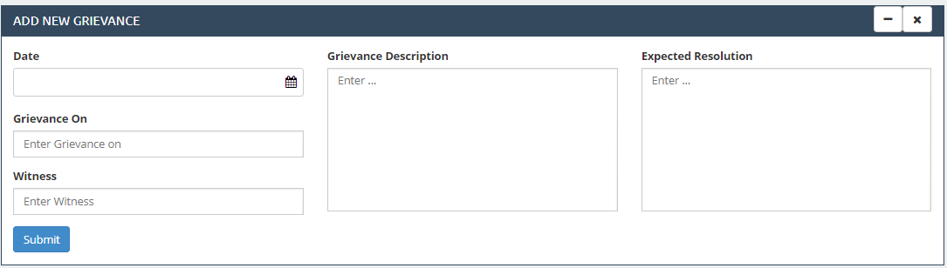
Entertaining New Grievance details
Step 1:
Select Date
Step 2:
Enter Grievance On
Step 3:
Enter Witness
Step 4:
Enter Grievance Description
Step 5:
Enter Expected Resolution
Step 6:
Click on Submit

Slide 7
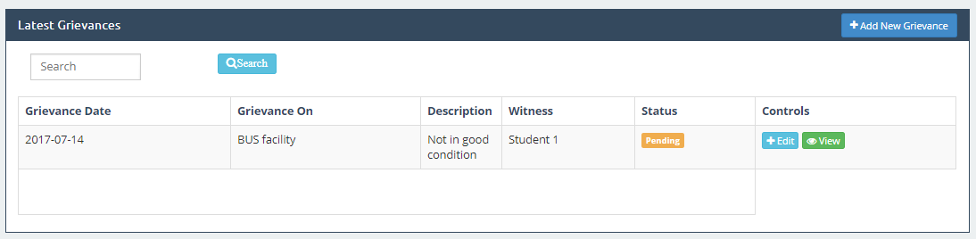
View Latest Grievances
Step 1: After submitting Grievances details will display in below table
Step 2: Click on View button to view the entered details
Step 3: Click on Edit button to change the details

Slide 8
My Complaints
Step 1:
Click on Grievances & Complaints
Step 2:
Click on My Complaints

Slide 9
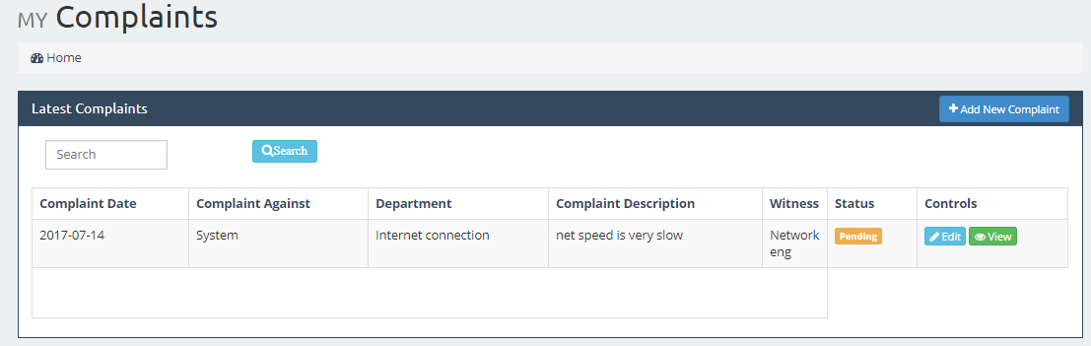
My Complaints
Click on Add New Complaint Button

Slide 10
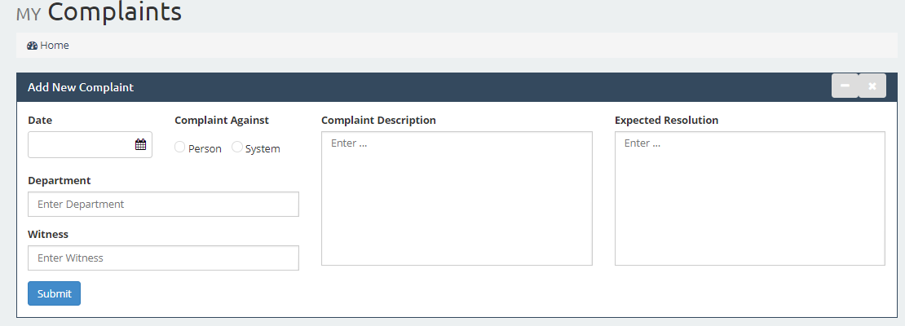
Add New Complaint
Step 1: Select Date
Step 2: Select person or System
Step 3: Enter Department Name
Step 4: Enter Witness Name
Step 5: Enter Complaint Description
Step 6: Enter Expected Resolution
Step 7: Click on Submit Button

Slide 11
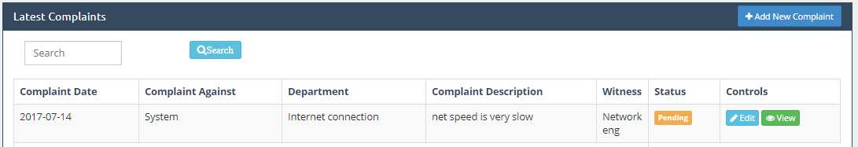
View Latest Complaints
Step 1: After submitting complaint details will display in below table
Step 2: Click on View button to view the entered details
Step 3: Click on Edit button to change the details

Slide 12


